Slide 1
Lent Calendar 2019
M T W Th F
Week:
6 Mar
7 Mar
8 Mar
One
11 Mar
12 Mar
13 Mar
14 Mar
15 Mar
Two
18 Mar
19 Mar
20 Mar
21 Mar
22 Mar
Three
25 Mar
26 Mar
27 Mar
28 Mar
29 Mar
Four
1 Apr
2 Apr
3 Apr
4 Apr
5 Apr
Five
8 Apr
9 Apr
10 Mar
11 Apr
12 Apr
Six
15 Apr
16 Apr
17 Apr
18 Apr
20 Apr
…because no one should go hungry.

Slide 2
Wednesday 6 March
Ash Wednesday
Think about…
As Lent begins, we remember how Jesus spent 40 days in the desert.
While Jesus was in the desert he had very little to eat or drink.
There are many people around the world who do not have basic things like enough food or clean water.
Throughout Lent we will think about our neighbours around the world who live in poverty.
Click here for a Lent liturgy (perfect for Ash Wednesday)

Slide 3
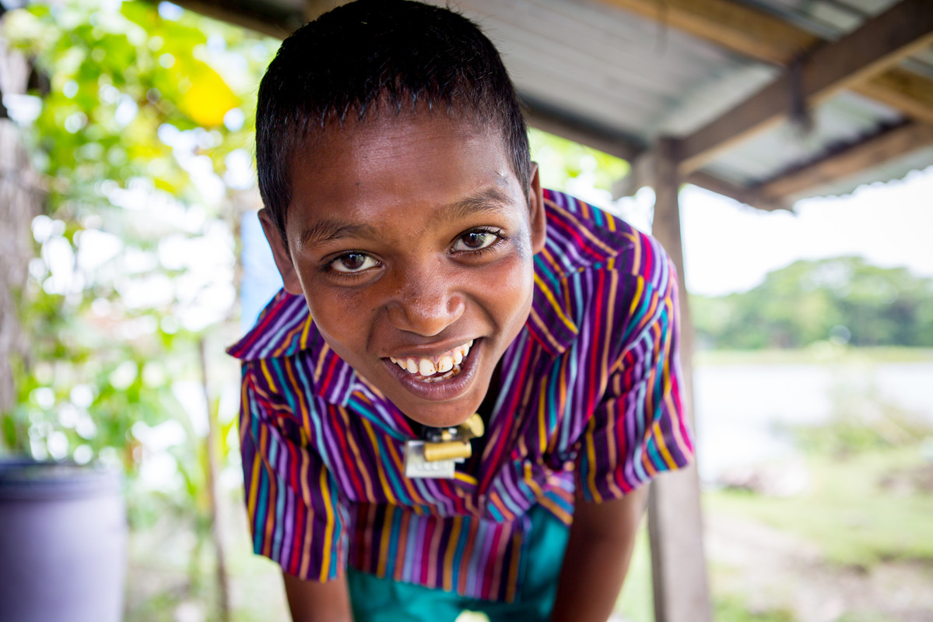
Thursday 7 March
Act
Meet Rabiul.
He lives in Bangladesh with his family.
Watch Rabiul’s film to find out about his story

Slide 4
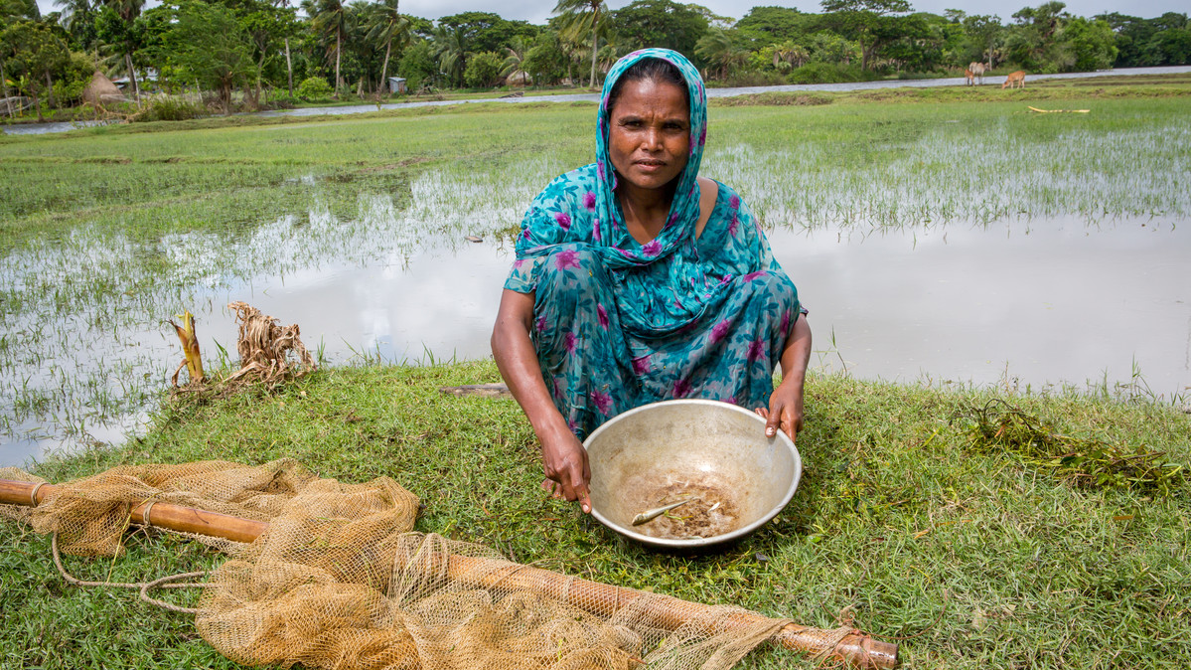
Friday 8 March
International Women’s Day
Act
Rabiul’s mum, Mahinur relies on a river for fish to feed her family. But this year, because of climate change, there are no fish for her to catch.
Tell someone about her story so that we can all work together to build a brighter world.

Slide 5
Monday 11 March
Give
Take the give it up challenge this Lent to build a better world, where people do not live in poverty.
Watch our give it up film.
It’s simple:
Choose something, give it up and donate the money.
Or choose something extra challenging to give up and get sponsored!

Slide 6
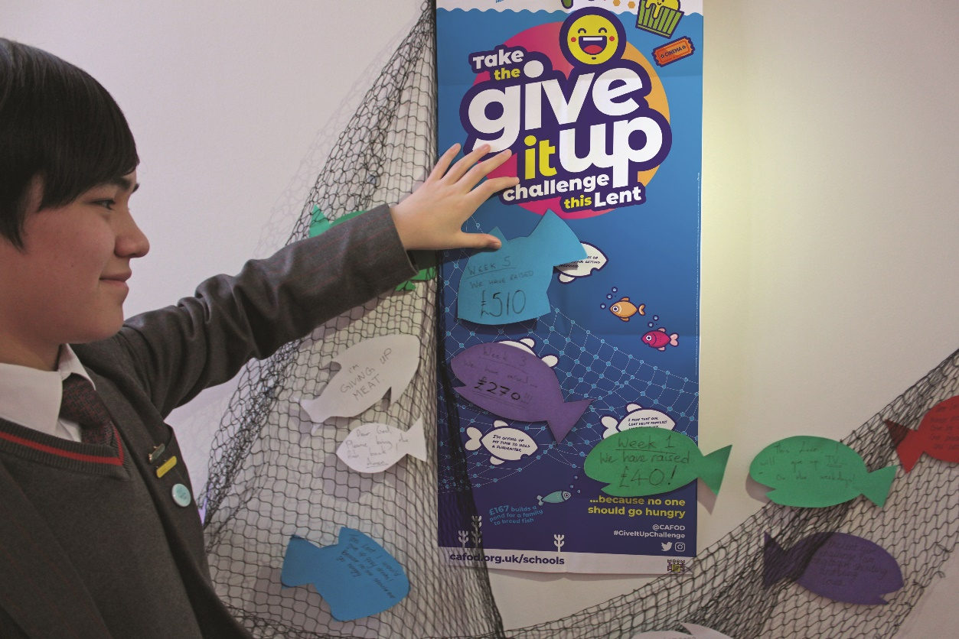
Tuesday 12 March
Give
As part of the give it up challenge, this year you can create a display using the Lent poster.
Write what you’re giving up, or a message to Rabiul, or a prayer on the fish template and add to the poster, or your display.
Send us photos of your fantastic displays here.

Slide 7
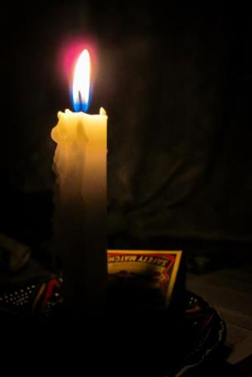
Wednesday 13 March
Pray
Light a candle and say a prayer so all children around the world may have the basic things in life, like enough food or clean water.
Loving God,
Help us to work together to share what we have so that everyone has what they need.
Help us to build a better world where each of us can become the best person we can be.
Amen

Slide 8
Thursday 14 March
Give
Did you know your fundraising can help families like Rabiul’s?

Slide 9
Friday 15 March
Family Fast Day
Give
Today is Family Fast Day!
Give up a treat today and put the money you save towards your give it up Lent collection, because no one should go hungry.
Use our give it up Lent assembly today

Slide 10
Monday 18 March
Give
Taking the give it up challenge can be simple!
You could give up chocolate and donate the money you save.
You could go the extra mile and get sponsored for giving up something bigger.
Check out our give it up film here

Slide 11
Tuesday 19 March
Pray
Light a candle and say a prayer so all children around the world may have the basic things in life, like enough food or clean water.
Loving God,
Help us to work together to share what we have so that everyone has what they need.
Help us to build a better world where each of us can become the best person we can be.
Amen

Slide 12
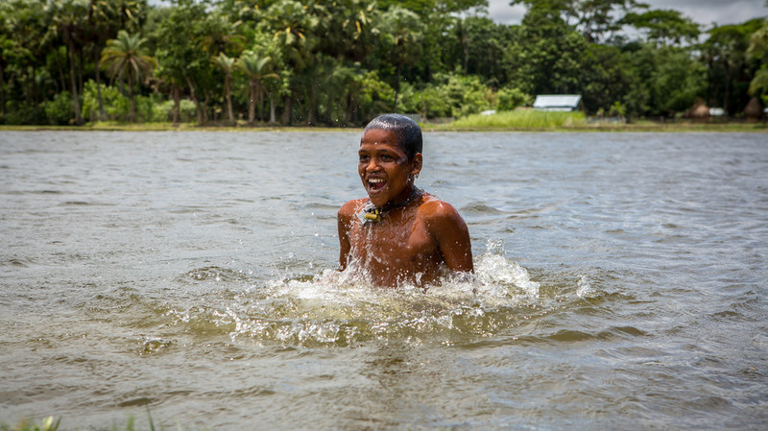
Wednesday 20 March International Day of Happiness
Act
Today is International Day of Happiness. What action will you take to show kindness to others?
Think of at least three things you can do today and during the next week of Lent to help bring happiness to other people.

Slide 13
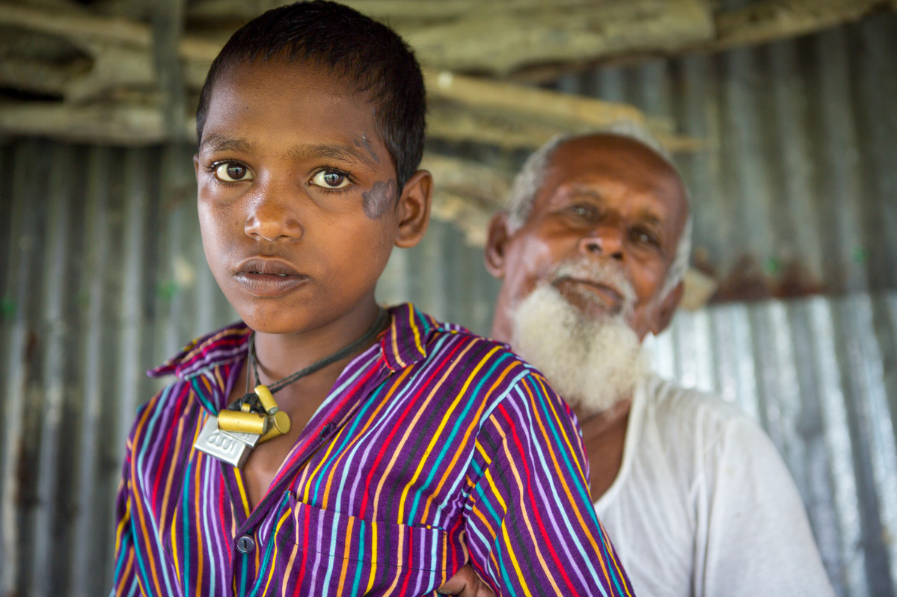
Thursday 21 March
Think about…
“I have come so that they may have life, and have it to the full” John 10:10
Say these words together and spend some time today thinking about them.
Where do these words come from?
What do they mean?
How can we live by them?

Slide 14
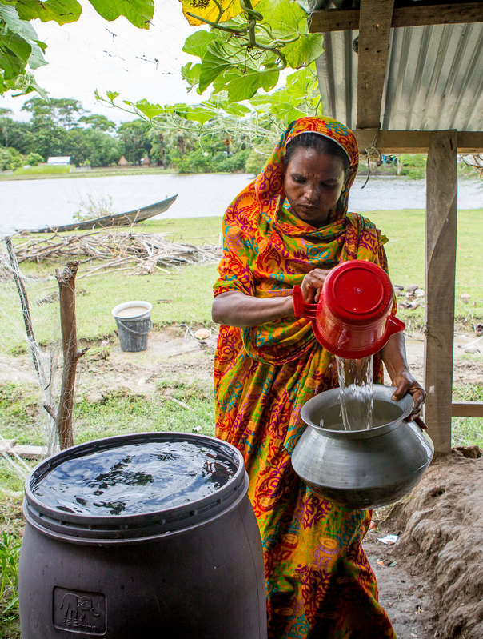
Friday 22 March
World Water Day
Act
Today is World Water Day.
Around the world 1 in 9 people don’t have clean water close to home.
Everyone needs safe water for drinking, washing, cleaning, cooking and growing food. It is a basic human right.
Watch the animation to find out more about water and why it is so important

Slide 15
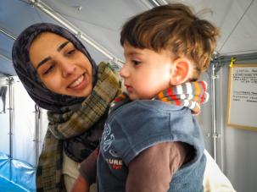
Monday 25 March
The Feast of the Annunciation
Pray
Today we celebrate a special day called the Annunciation.
It’s the day when we celebrate the angel Gabriel visiting Mary to tell her the good news that she would be the mother of Jesus.
Let us pray
Hail Mary, full of grace, the Lord is with thee; blessed art thou among women,
and blessed is the fruit of thy womb, Jesus.
Holy Mary Mother of God,
pray for us sinners,
now and at the hour of our death.
Amen
Find our annunciation resources here

Slide 16
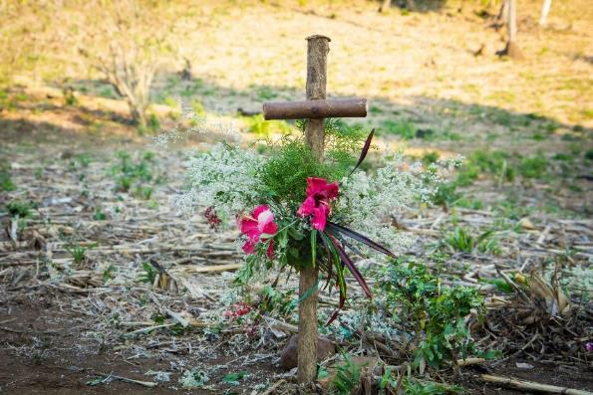
Tuesday 26 March
Pray
Reflect on one of the Stations of the Cross today.

Slide 17
Wednesday 27 March
Pray
Light a candle and say a prayer so all children around the world may have the basic things in life, like enough food or clean water.
Loving God,
Help us to work together to share what we have so that everyone has what they need.
Help us to build a better world where each of us can become the best person we can be.
Amen

Slide 18
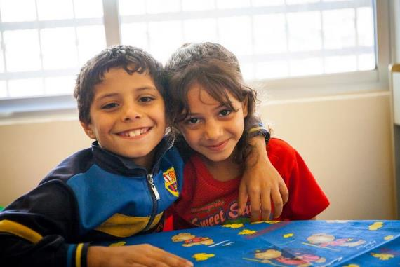
Thursday 28 March
Act
What action will you take to show kindness to others today?
Think of at least three things you can do today and during the next week of Lent.
You could think of three different people to show kindness to, maybe someone you don’t always get on with or someone you wouldn’t normally talk to.

Slide 19
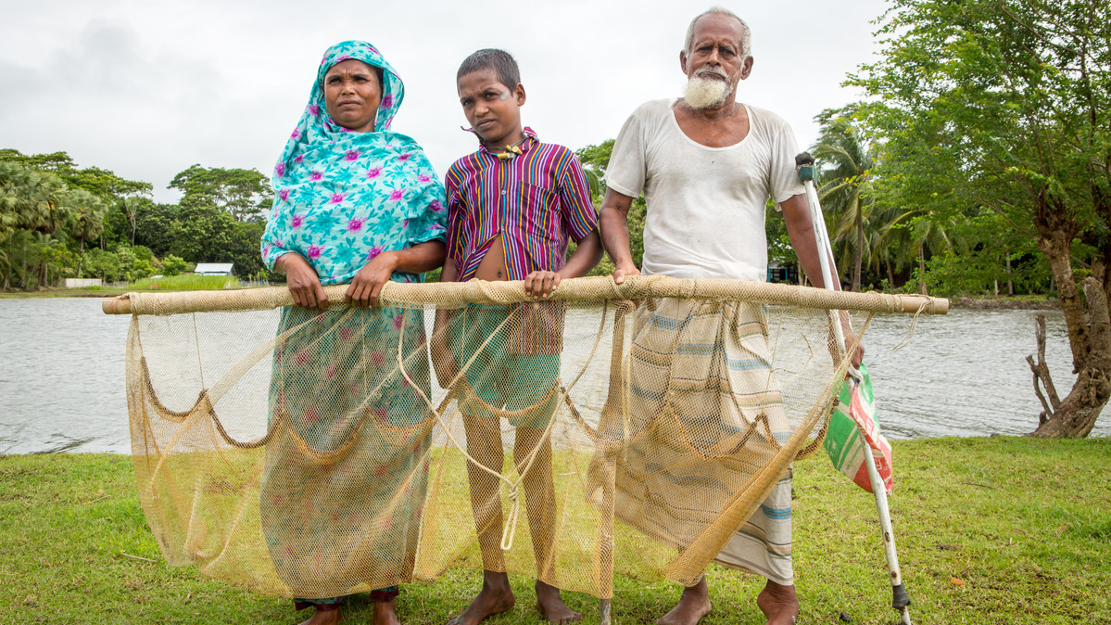
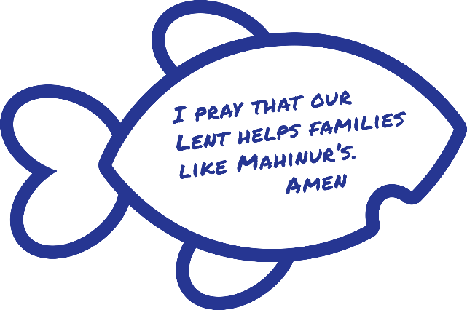
Friday 29 March
Think about…
Remember Rabiul and Mahinur?
Here they are with Rabiul's dad, Khalek.
Write a message to Rabiul and Mahinur on a fish and add it to your poster display.
Rewatch their film.

Slide 20
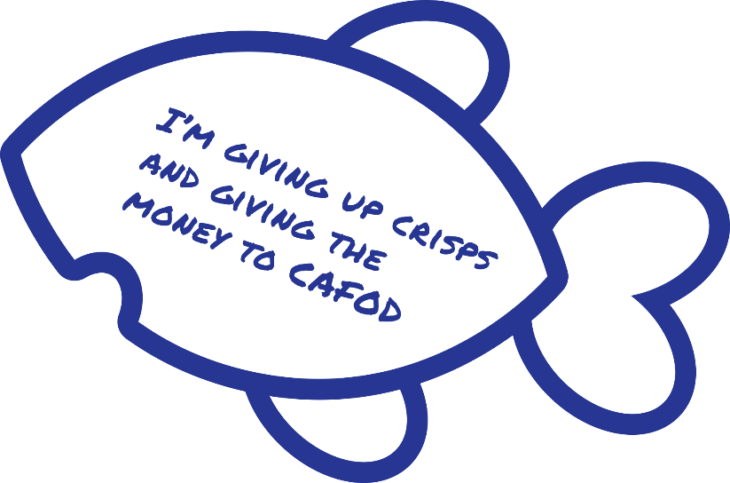
Monday 1 April
Give
Keep up the great work on your give it up challenge!
Remember to write what you’re giving up on a fish – the money you save and donate to CAFOD will help communities like Rabiul’s.

Slide 21
Tuesday 2 April
Pray
Reflect on one of the Stations of the Cross today.

Slide 22
Wednesday 3 April
Pray
Light a candle and say a prayer so all children around the world may have the basic things in life, like enough food or clean water.
Loving God,
Help us to work together to share what we have so that everyone has what they need.
Help us to build a better world where each of us can become the best person we can be.
Amen

Slide 23
Thursday 4 April
Give
Did you know your fundraising can help families like Rabiul’s?

Slide 24
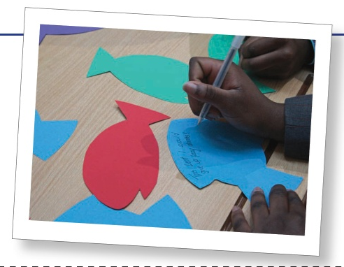
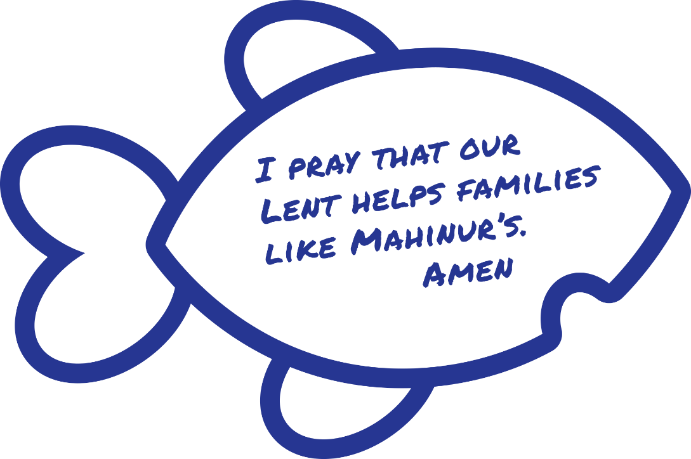
Friday 5 April
Pray
Only 2 more weeks until Easter.
Why not write a prayer to add to your display?

Slide 25
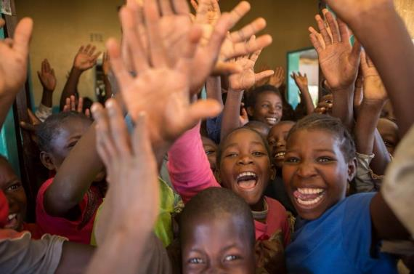
Monday 8 April
Act
Easter is nearly here.
Start getting ready by making Easter cards for your family and friends.

Slide 26
Tuesday 9 April
Pray
Reflect on one of the Stations of the Cross today.

Slide 27
Wednesday 10 April
Pray
Light a candle and say a prayer so all children around the world may have the basic things in life, like enough food or clean water.
Loving God,
Help us to work together to share what we have so that everyone has what they need.
Help us to build a better world where each of us can become the best person we can be.
Amen

Slide 28
Thursday 11 April
Give
Keep up the great work on your give it up challenge!
Remember the money you save and donate to CAFOD will help communities like Rabiul’s.
Rewatch Rabiul’s film here

Slide 29
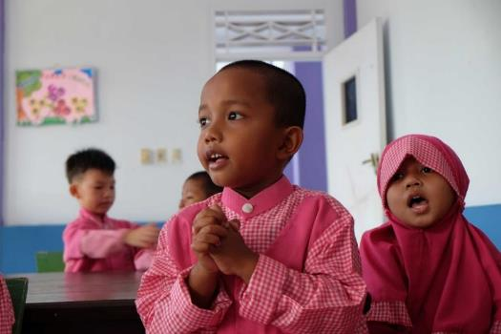
Friday 12 April
Give
Easter is nearly here.
Find out whether your local shop sells Fairtrade Easter eggs. If not, ask them why not and if they will stock them next year.
Find our Fairtrade resources here

Slide 30
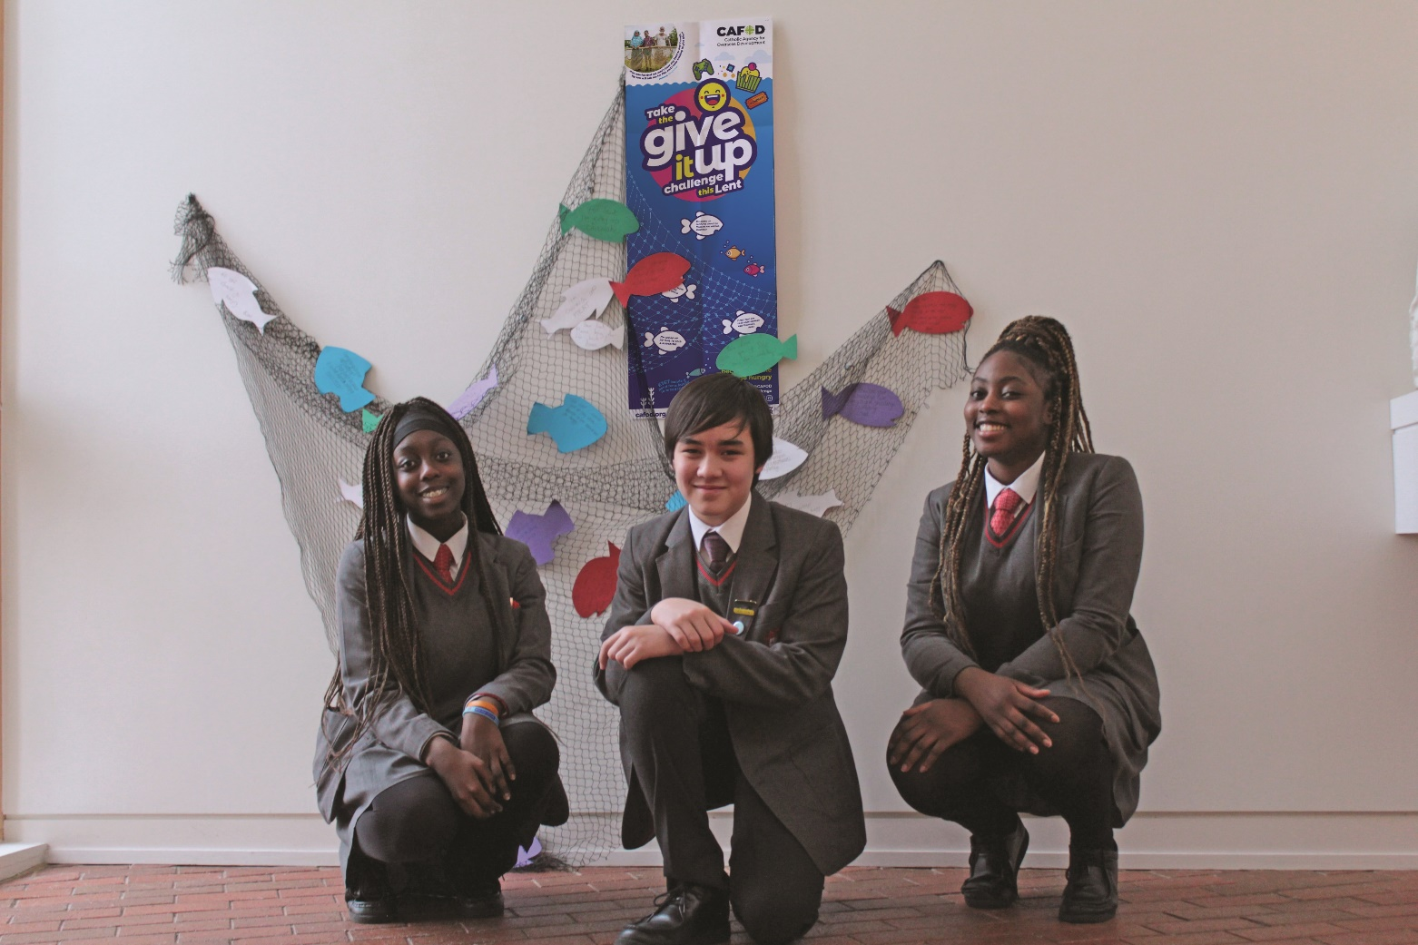
Monday 15 April
Act
Write thank you messages to people who sponsored you or gave you money for the give it up challenge this Lent.
You could write your thank you message on a fish.
Thank you!

Slide 31
Tuesday 16 April
Pray
Reflect on one of the Stations of the Cross today.

Slide 32
Wednesday 17 April
Pray
Light a candle and say a prayer so all children around the world may have the basic things in life, like enough food or clean water.
Loving God,
Help us to work together to share what we have so that everyone has what they need.
Help us to build a better world where each of us can become the best person we can be.
Amen

Slide 33
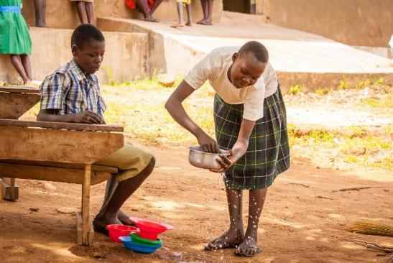
Thursday 18 April
Holy Thursday
Think about…
Today Jesus washed his disciples feet at the Last Supper.
Think about how you can serve others.

Slide 34
Friday 19 April
Good Friday
Pray
Say a prayer today for people around the world who live in poverty.
Remember those families that do not have basic things like food, housing and clothing.

