Slide 1
To welcome our new Bishop

Slide 2
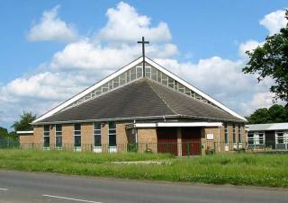
Our Parish
Our school is in the parish of St Mark’s

Slide 3
Our parish and all the parishes around us are in the Diocese of Hexham and Newcastle.
The Diocese of Hexham and Newcastle covers a large part of the North East of England including the counties of Northumberland, Tyne and Wear, Durham and the part of Cleveland north of the River Tees.

Slide 4
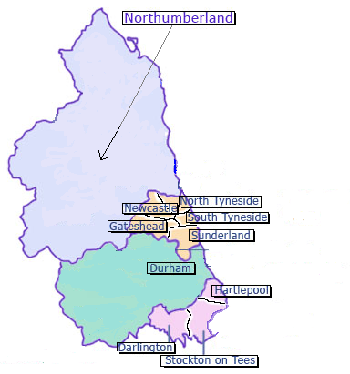
Diocese of Hexham and Newcastle
Darlington
Durham
Gateshead
Hartlepool
Newcastle
North Tyneside
Northumberland
South Tyneside
Stockton
Sunderland

Slide 5
A Diocese is made up of many parishes. The Bishop leads the Christian family in his Diocese. The main church in a diocese is called a Cathedral. The cathedral in the Diocese of Hexham and Newcastle is the Cathedral Church of St Mary in Newcastle. The Cathedral is 175 years old this year.
http://stmaryscathedral.org.uk/

Slide 6
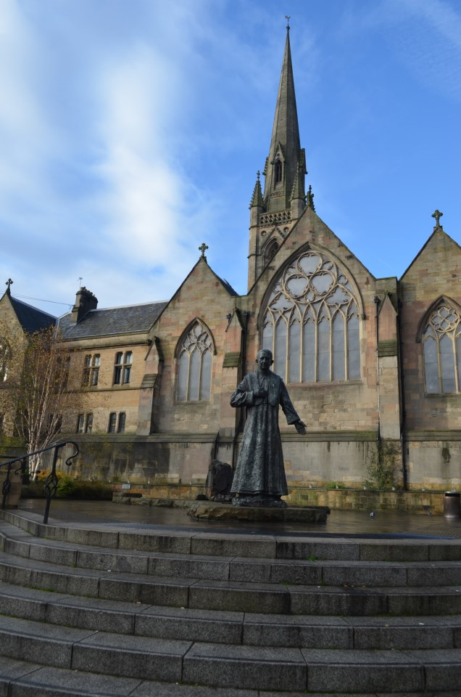
Cathedral Church of St Mary, Newcastle

Slide 7
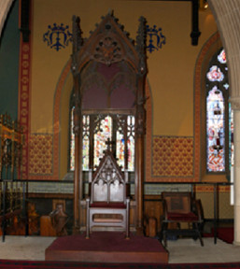
‘Cathedral’ comes from a Latin word meaning ‘seat’, so the cathedral is where the diocesan bishop has his ‘seat’. This is the symbol of his responsibility and authority, and he takes his seat here when he celebrates Mass.

Slide 8
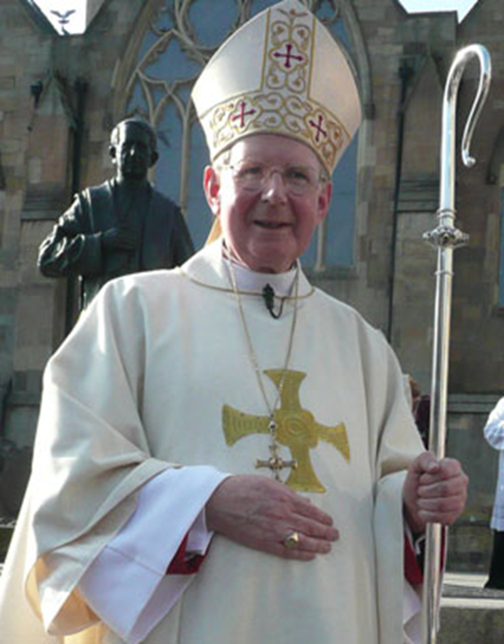
A bishop is like a shepherd because he looks after and cares for his people as a shepherd cares for his sheep.
He wears a mitre, a cross and a special ring and he carries a carries a crozier.

Slide 9
The mitre is worn on his head and symbolises the two sources of his authority – the Bible and the Church.
The cross shows he walks in the footsteps of Christ.
The ring shows he is faithful to God and to leading his people.
The crozier is a symbol of how he is like a shepherd.

Slide 10
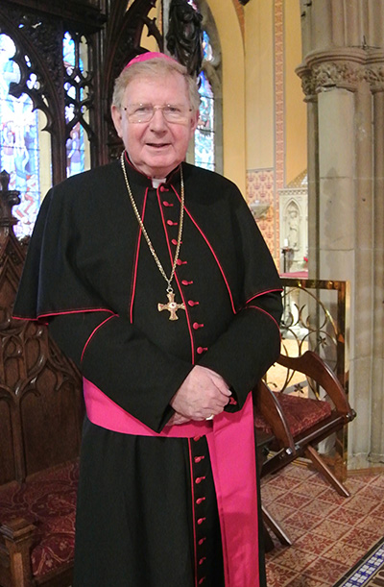
Bishop Séamus Cunningham has been the Bishop of Hexham and Newcastle since 2009. He is now retiring and the Pope has appointed a new bishop.

Slide 11
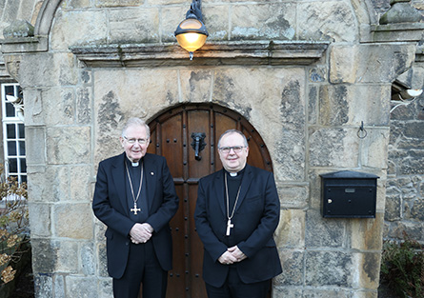
Bishop Robert Byrne from The Archdiocese of Birmingham has been appointed to be the fourteenth Bishop of Hexham and Newcastle.

Slide 12
Bishop Byrne was born in Manchester on 22 September 1956. He was ordained a priest in 1985 and Auxiliary Bishop of the Archdiocese of Birmingham on 13 May, 2014.
Bishop Byrne said: “I am deeply humbled by the trust Pope Francis has placed in me with this appointment as Bishop of Hexham & Newcastle.”

Slide 13
“I look forward to making my home in the North East, with its rich Christian heritage, and also getting to know and serve the people, deacons, religious and priests of the Diocese.
I ask all of you to keep me in your prayers as I pray for you.”
Let us say a prayer now for our ‘old’ and our ‘new’ bishops.

Slide 14
Loving God
We thank you for the work of Bishop Seamus.
We pray that he enjoys a long, happy and fulfilling retirement.
We give thanks for Bishop Robert.
We ask that you send him strength and wisdom to lead our diocesan family.
We pray that he will feel welcomed and happy in his new home.
Through Christ our Lord. Amen

